Slide 1

HYBRID IMAGE RESTORATION
National Polytechnic University of Armenia
Student: Andy Younes
Supervisor: PhD, Arman Grigoryan
Notes:
Hello my name is Andy, and I am going to be defending my thesis today on Hybrid Image Restoration. This presentation consists of 4 sections:

Slide 2
01
02
INTRODUCTION
PROBLEM STATEMENT
03
04
DEVELOPMENT
CONCLUSION
Introducing the project
Statement of the problem
Content, development and results.
Conclusion of the project
Notes:
- intro, problem statement, development and conclusion

Slide 3
01. INTRODUCTION
Introducing the projects

Slide 4
INTRODUCTION
Hybrid machine learning algorithms for restoring images bring together the best of traditional methods and the latest in deep learning methods. It is combining the traditional techniques with the innovative power of cutting-edge technology to restore images. This algorithm works by blending different approaches to tackle the challenges of fixing up degraded images. By doing so, we can clean up noise, sharpen blurry spots, and make the whole picture clearer and more vibrant.
Notes:
My algorithm brings together the best of traditional methods to restore together the best of new technologies and ML algorithms to being together the most accurate results. It works by blending different approaches to fix the image. By doing so we clean up the noise, sharpened blurriness, and should make the picture clearer.

Slide 5
02. PROBLEM STATEMENT
How to achieve our goals, the statement of the problem.

Slide 6
PROBLEM STATEMENT
We aim to create a novel ML algorithm addressing traditional image degradation and enhancing existing restoration techniques. The Hybrid Image Restoration algorithm targets deblurring, denoising, and colorization, integrating both approaches.
The solution will involve:
Dataset Curation: A diverse dataset capturing noise, blurriness, and color variations for training will be curated.
Neural Network Design: Interpretability and transparency, exploring parameters like MSE pixelation, encoders, and autoencoders will be incorporated.
User-Centric Web Application: Flask and RESTful API for real-time restoration demonstrations will be implemented.
Notes:
We want to create a ML algorithm by blending traditional techniques of degradation and enhancing existing restoration techniques. The model should target denoising, deblurring, colorization and resizing with both of these approaches. The solution involves: 1. Dataset Curration, where we collect dataset of different images capturing all of the requirements. 2. NND, we want to explore parameter like Mean squared error, encoders an autoencoders.
3. Web Application where Flask and Restful API for real time restoration will be implemented

Slide 7
03. DEVELOPMENT
Content, development and results.
Notes:
The development process consists of 6 steps

Slide 8
DEVELOPMENT
Step 1: Collect Data
Step 2: Resize Data
Step 3: Train the Model
Step 4: Testing Model
Step 5: Implementing model with API
Step 6: See Results
Notes:
Step 1: Collect data, we first start by collecting data with images that have blurriness and colorization by pairs, and divide them into groups of burred, unblurred, colorized and grayscale. Step 2: Resize Data, we resize all of the images to 128 x 128 Step 3: Train the model
Step 5: we have the web application created, now we implement model with API Step 6: Check the results in the web application

Slide 9

VISIT MY WEB!
Notes:
My website

Slide 10

Main Page, Menu and Its components

Slide 11
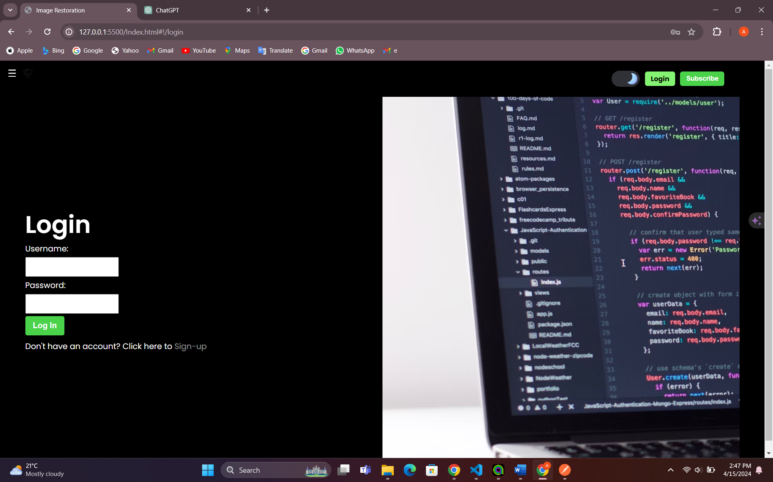
Login Page, and Href link to Sign up Page

Slide 12

Sign Up Page with option to Subscribe

Slide 13

Subscribe Page with Two Options, Sign Up for free or Premium Subscribe
Notes:
The only difference between free plan and premium plan is: The free plan, only sends an email and updates about new machine learning algorithms related to image restoration. The premium plan gives full access and updates about the Hybrid ML

Slide 14

Home Page with Its Components
Notes:
Our home page is dedicated to discuss further about introduction of the project, examples of image restoration such as removing noise from a vintage photograph, explaining how, image inpainting. We also explain pixelation with detailed explanation, hybrid machine learning algorithm that we developed, various other machine learning algorithms for restoring images and the process of image restoration.

Slide 15
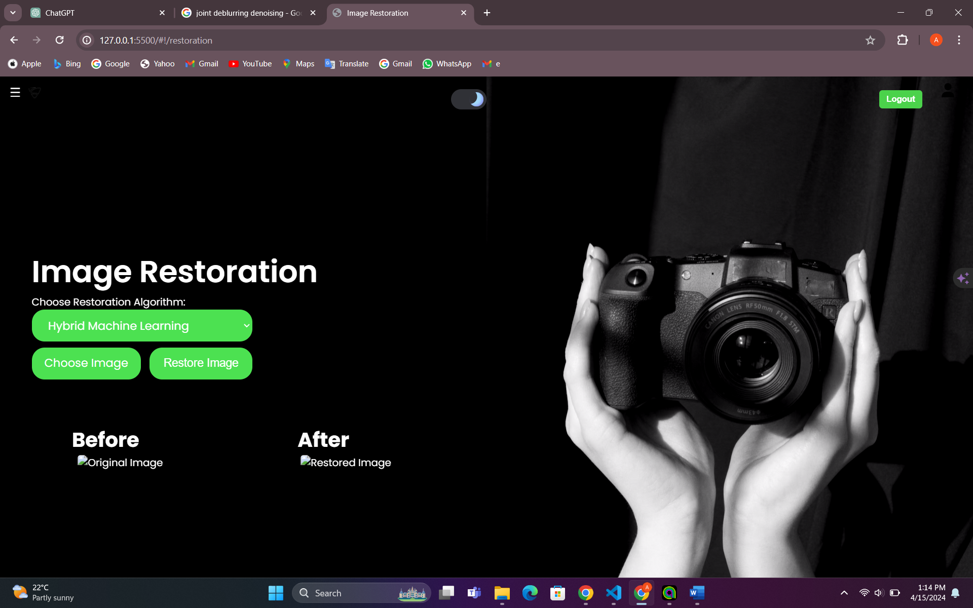
Restoration Page
Notes:
For Image Restoration Web Page as shown in we have 3 buttons, choose your algorithm as shown in the next slide,

Slide 16
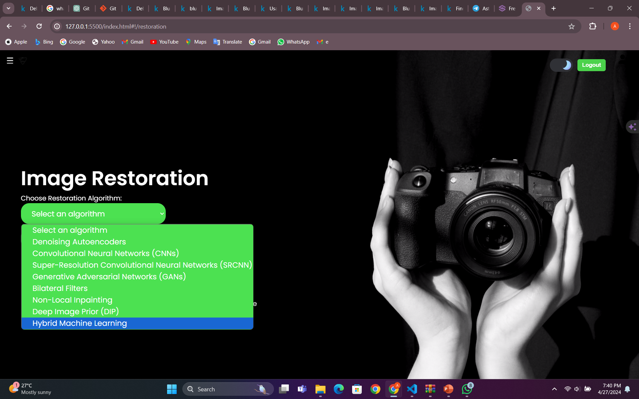
Choosing an Algorithm
Notes:
choose your image as shown in this next slide

Slide 17
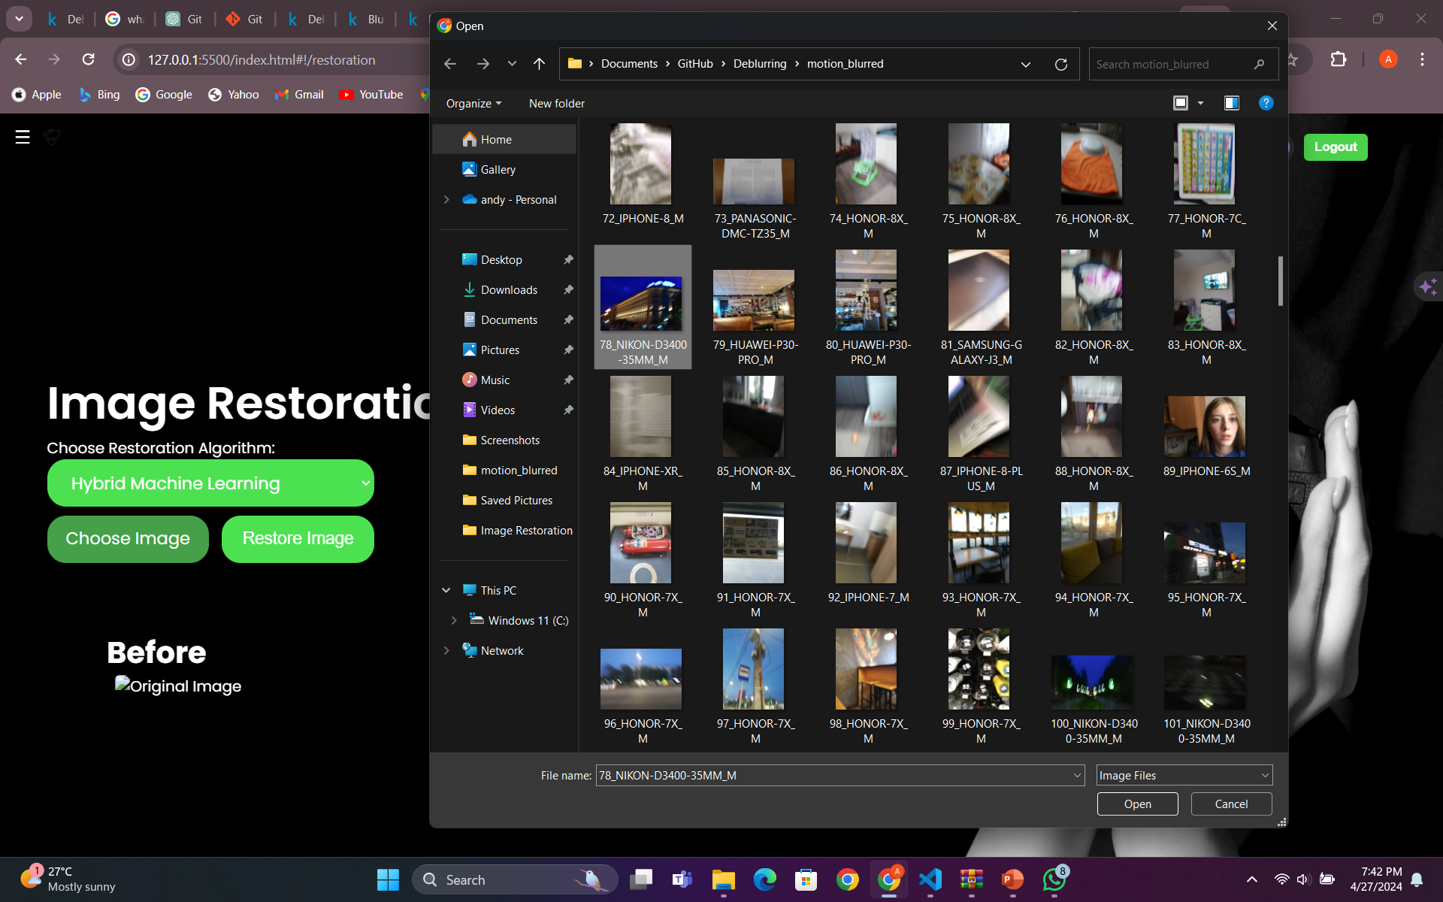
Choosing a Picture

Slide 18
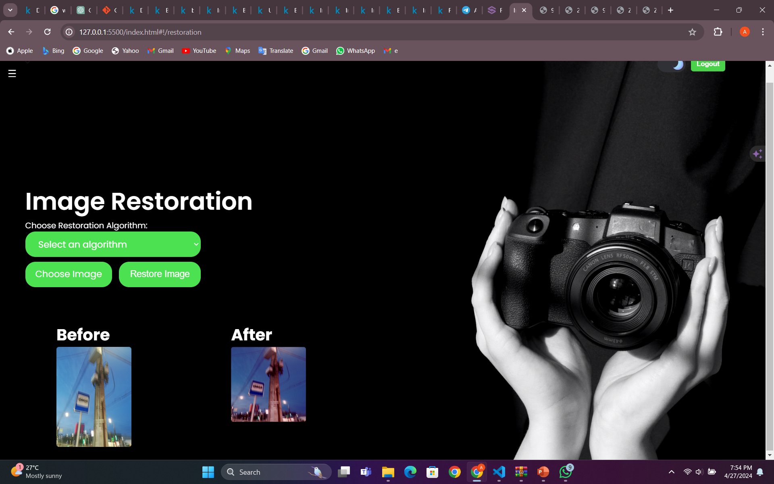
Restoring the chosen Image
Notes:
and restore image as shown in here. Using Flask API endpoint for deblurring images. It loads a pre-trained deblurring model and defines a function to preprocess images for deblurring. When an image is sent to the '/deblur' endpoint via a POST request with the image encoded in base64 format, the image is preprocessed, deblurred using the loaded model, and then encoded back to base64 format. The deblurred image is returned as a response in JSON format. If any errors occur during the process, an error message is returned instead.

Slide 19
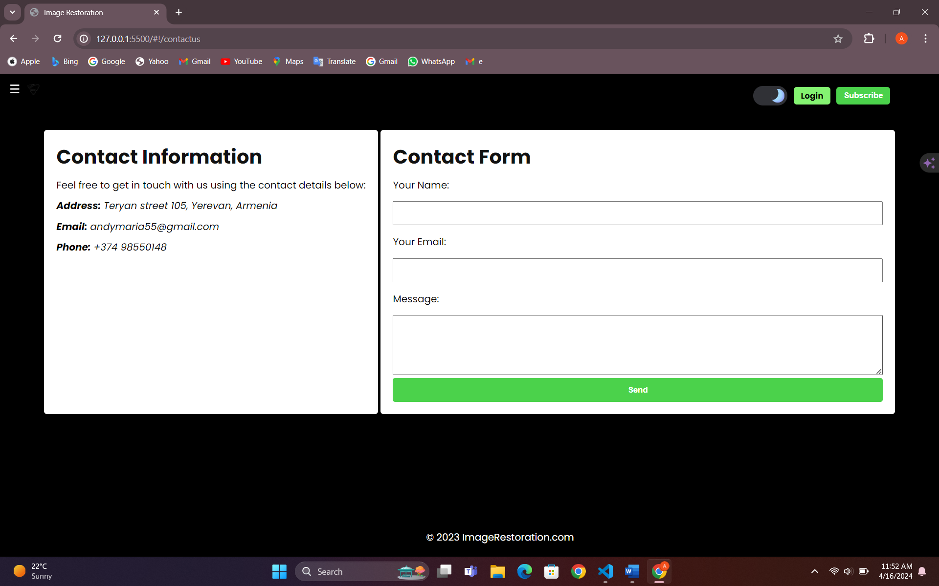
Contact us Page and Its Components
Notes:
In the contact form, this page consists of contact information, address, email, and the user address the complaints with email, name and the message.

Slide 20
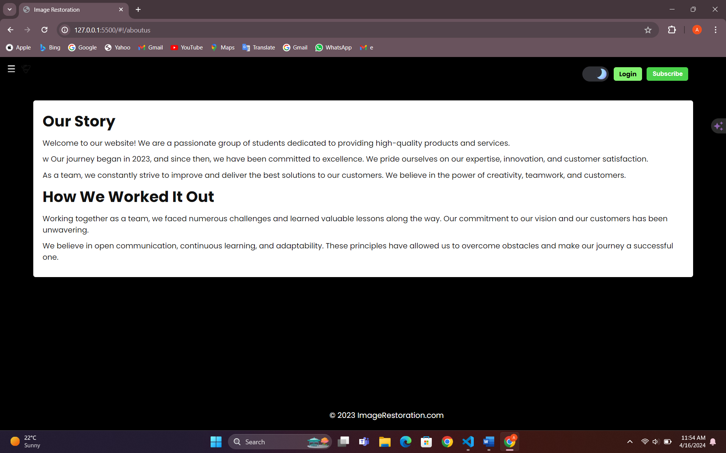
About Us Web Page

Slide 21
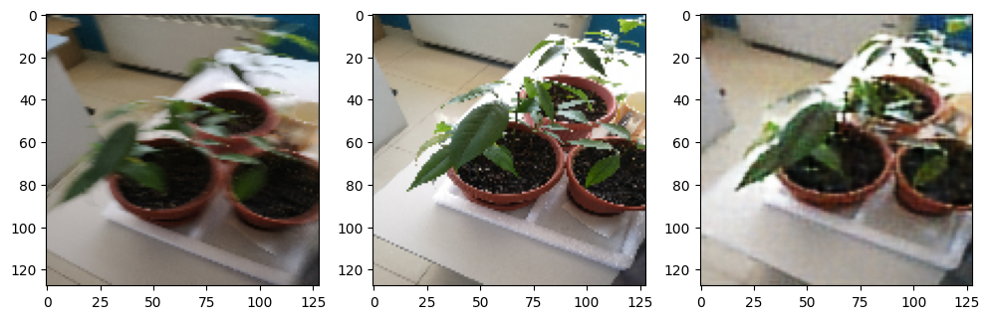
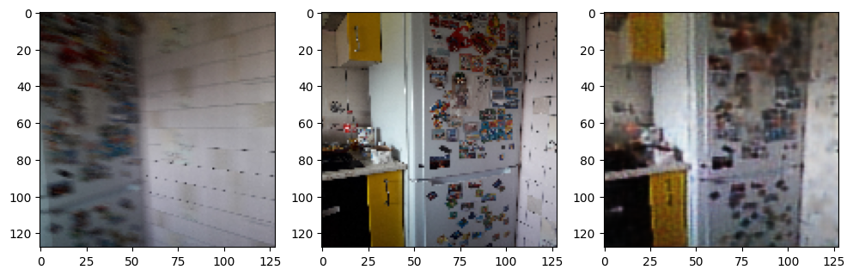
Machine Learning training and Results
Notes:
The algorithm uses Mean Squared Error (MSE) to judge how well it recreates images, aiming to make the recreated ones as close as possible to the originals. It's like checking how accurate a copy is to the original picture. The method involves two parts: one squeezes the picture into a simpler form, while the other rebuilds it. During training, it constantly adjusts to make the recreated pictures match the originals better. Converting colors and dealing with noise during training helps make the final images clearer and more robust. Techniques like removing noise without losing important details and correcting blurry parts play a big role in making the images look better overall, like getting rid of graininess and sharpening fuzzy areas. MSE=n1​∑i=1n​(yi​−y^​i​)2
Where:
𝑛n is the number of observations.
𝑦𝑖yi​ is the actual value of the target variable for the 𝑖𝑡ℎith observation.
𝑦^𝑖y^​i​ is the predicted value of the target variable for the 𝑖𝑡ℎith observation.
MSE calculates the average squared difference between the actual and predicted values. It is commonly used as a measure of the quality of an estimator or predictor in statistical modeling.
------------------------------------------------------------------------------------------------------------------------------------------------------------------------------------------------------------ One key component of the algorithm was the utilization of Mean Squared Error (MSE) as a metric for evaluating the quality of reconstructed images. By optimizing MSE, the algorithm aimed to minimize the difference between the original and reconstructed images, thereby enhancing overall image quality as shown The autoencoder-decoder architecture is a powerful deep learning model commonly used for unsupervised learning tasks, such as image reconstruction and feature learning. It consists of two main components: an encoder and a decoder. The encoder compresses the input data into a low-dimensional latent space representation, while the decoder reconstructs the original data from this compressed representation.
Encoder: The encoder component of the autoencoder takes an input image and passes it through a series of convolutional and pooling layers, gradually reducing the spatial dimensions of the input while increasing the number of feature channels. These convolutional layers learn to extract hierarchical features from the input image, capturing important patterns and structures. The final output of the encoder is a compressed representation of the input image in the form of a low-dimensional feature vector, often referred to as the latent space representation.
Decoder: The decoder component of the autoencoder takes the compressed representation generated by the encoder and performs the inverse operation. It upsamples the latent space representation back to the original spatial dimensions of the input image while decreasing the number of feature channels. Through a series of convolutional and upsampling layers, the decoder learns to reconstruct the original image from the compressed representation. The output of the decoder is the reconstructed image, which ideally closely resembles the input image.
To train the autoencoder-decoder architecture, we used a combination of loss functions, including Mean Squared Error (MSE), to quantify the difference between the reconstructed images and the original input images. During training, the model adjusts its parameters to minimize this reconstruction error, thereby learning to generate more accurate reconstructions.
Within the decoder component, we employed techniques such as BGR2RGB color space conversion to preprocess images and enhance their visual quality. By converting images from the BGR color space (commonly used in computer vision tasks) to the RGB color space (more commonly used in image processing and visualization), we aimed to improve color representation and consistency in the reconstructed images.
Furthermore, the algorithm utilized color space conversion techniques, such as BGR2RGB conversion, to preprocess images and enhance their visual clarity. By converting images from the BGR color space to the RGB color space, the algorithm aimed to improve color representation and consistency, thereby further enhancing the quality of reconstructed images.
We applied Noise masking and demasking it involves the intentional addition of noise to an image as part of the training process for a machine learning model. By introducing noise into the training data, the model learns to adapt to and effectively handle noisy inputs, leading to improved generalization performance and robustness. Noise demasking, on the other hand, involves the removal or reduction of noise from an image to improve its quality and clarity. This process is typically achieved using various denoising techniques, such as filtering algorithms, neural network-based approaches, or a combination of both.
In our hybrid machine learning algorithm, noise masking may be implemented by adding artificial noise to the input images during the training phase. This noise can take various forms, such as Gaussian noise, salt-and-pepper noise, or random speckles, simulating real-world noise sources that commonly affect images captured in diverse environments. On the other hand, noise demasking is a critical component of the image enhancement pipeline. After training the model on noisy input-output pairs, the trained model can be applied to remove noise from new, unseen images, thereby enhancing their visual quality.
For denoising, the algorithm leveraged OpenCV's Non-local Means Denoising function, which applies a sophisticated denoising algorithm to remove noise while preserving image details. This function utilized a combination of spatial and tonal similarity measures to effectively filter out noise from the input images. By incorporating denoising techniques into the algorithm, it was able to produce cleaner and sharper image reconstructions, free from the detrimental effects of noise.
Additionally, for deblurring, the algorithm employed a combination of convolutional neural networks (CNNs) and image processing techniques to restore sharpness and clarity to blurry images. By training CNNs on a dataset of blurry and clean images, the algorithm learned to discern and correct blur-induced distortions, resulting in significantly improved image quality.

Slide 22
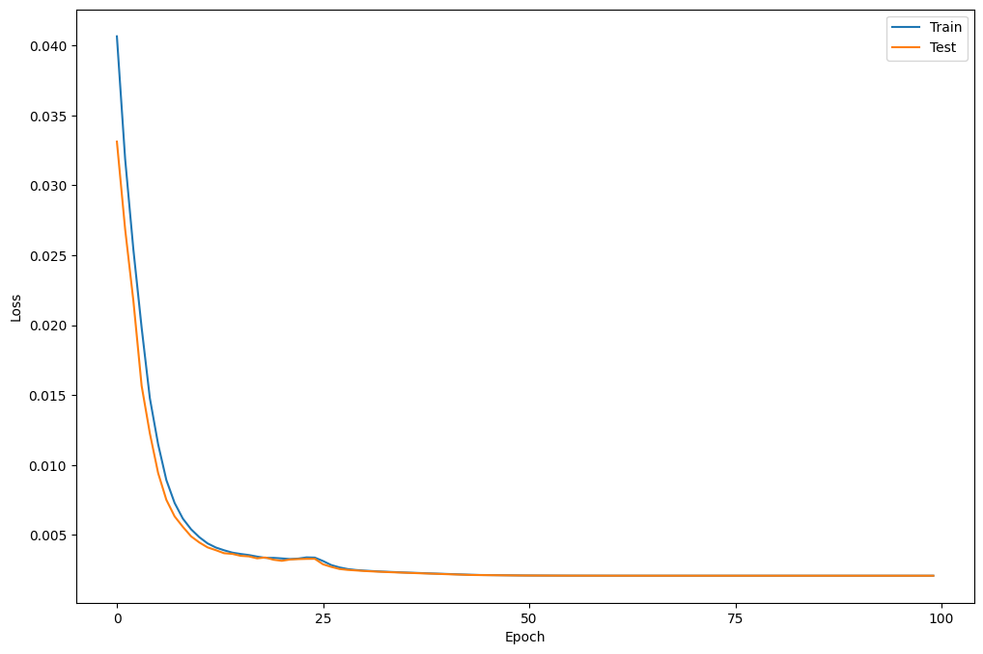
Loss of Epochs during training
Notes:
1. Epochs: In machine learning, an epoch refers to one complete pass through the entire training dataset during the training process. It represents the total number of iterations of all the training data in one cycle. Each epoch allows the model to update its parameters based on the training data, gradually improving its performance.
2. Loss of Epoch: Loss of an epoch represents the value of the chosen loss function (e.g., Mean Squared Error, Cross-Entropy) calculated after one epoch of training. It indicates how well the model is performing on the training data at that particular epoch. Lower loss values signify better model performance, indicating that the model's predictions are closer to the actual target values. Monitoring loss across epochs helps track the progress of model training and identify potential issues, such as overfitting or underfitting

Slide 23
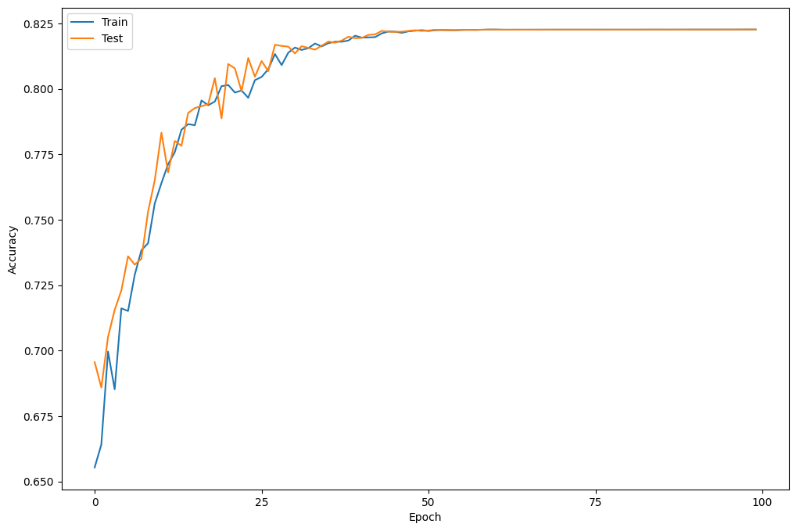
Accuracy of the Results

Slide 24
04. CONCLUSION
Conclusion & Future Approach.
.

Slide 25
CONCLUSION
The project succeeded in developing a state-of-the-art Hybrid Machine Learning Algorithm for Image Restoration, offering a powerful solution to the challenges of image degradation. With its versatility, accuracy, and user-centric design, the algorithm holds significant potential for various applications in fields such as healthcare, surveillance, and digital image processing.

Slide 26
THANK YOU!
Do you have any questions?
andymaria55@gmail.com
+374 98 550 140

